Slide 1
The Use of Online Medical Databases by Medical Students in the Faculty of Medicine, Naresuan University
December 25th, 2013
Naresuan University Hospital, Faculty of Medicine, Naresuan University
Notes:
Good afternoon everyone. We’er the final group today and now we pround to present our research that is The Use of Online Medical Databases by Medical Students in the Faculty of Medicine, Naresuan University

Slide 2
Research Team
Name | Student code
Suchada Boonpeng | 52461046
Pimchanok Chittanavakun | 52460710
Mr. Yeshi Galex | 52461342
5th year medical student, Faculty of medicine, Naresuan University
Notes:
There are Ms. Sudada Boonpeng, Mr Yeshi Galex, and I’m Pimchanok Chitanawakhun

Slide 3
Acknowledgment
Statistical and research advisor: นพ. สุวิทย์ เลิศขจรศิลป์ อาจารย์ภาควิชาวิจัย คณะแพทยศาสตร์ มหาวิทยาลัยนเรศวร
Content advisor: รศ.ดร.รัตติมา จีนาพงษา ผู้อำนวยการสำนักหอสมุดมหาวิทยาลัยนเรศวร , มหาวิทยาลัยนเรศวร, คณะเภสัชศาสตร์ , มหาวิทยาลัยนเรศวร

Slide 4
Title and Contents
Background
Objective
Assumption
Methodology
Result and Analysis of results
Conclusion
Notes:
Today, I’m going to present this study about ten minutes that compose of the background to the conclusion of the research.

Slide 5
Background

Slide 6
A lot of medical information
The movement towards evidence-based practice make more available and currently updated best evidence to improve health.
Notes:
The movement towards evidence-based practice makes explicit the need for access to current best evidence to improve health, which have been made more available and currently updated by the online medical database resources. Not only physicians, medical students have been affected by this evidence-based information as well.

Slide 7
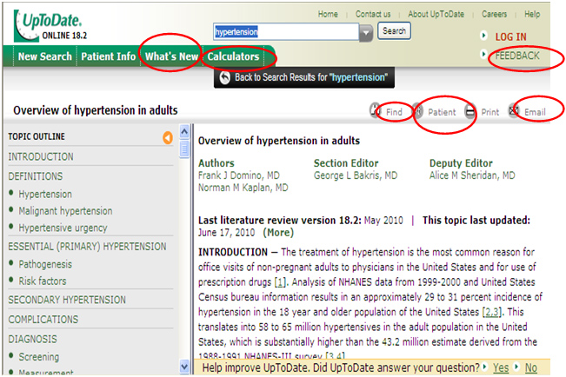
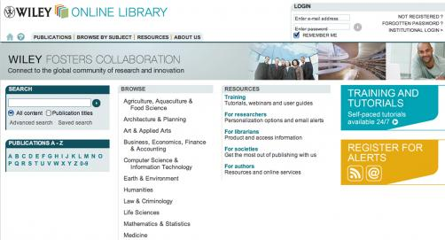
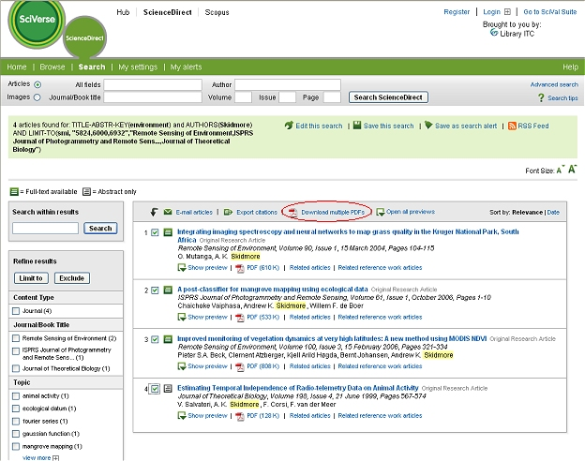
The online databases
Notes:
In this 21 century apart from goolgle, bing , onesearch database, there are many online databases that provide accurate and concise information according to the need of person. Which include access medicine, wiley , uptodate, md consult etc.. Which is easy to used and is being made available to every one in naresuan university.
The Naresuan University also has an online medical database services, but there’s no concrete research about using online medical databases .

Slide 8
Objective
To Determine the rate of using the online medical databases of medical student in Faculty of medicine, Naresuan University
To identify the problems of using the online medical databases
Notes:
The purpose of this study is to determine the rate of using online medical databases by medical students in Naresuan University. The problems of using the online medical databases are also identified.

Slide 9
Research Questions
How many medical students use online medical databases?
What are there problems of using online medical databases in medical student?
Notes:
This research made an assumption that the rate of using online database varies betweeen clinic and preclinic medical student and its assumed that clinical students used more online database compare to preclinic student because they directly deals with a patients inorder to treat and manage them.
Both preclinic and clinic have problems in using online database. Some lack knowledge of online database and have no idea how to access them whereas some prefer thai textbook.

Slide 10
Methodology
Notes:
Ok next I’m going to present methodology of this reseach

Slide 11
Methodology I
Design: Survey research, Cross-section study
Population: Medicine student in Faculty of Medicine Naresuan University of 909 people, 2555
Sampling: 278 samples
Pre-clinical student (1st–3rd year)
Clinical student (4th-6th year)
Notes:
Methodology: A quantitative cross-sectional survey of 278 were distributed randomly to the medical students in Faculty of Medicine,
which composed of 2 groups of student which are pre-clinical student (1st–3rd year) and clinical student (4th-6th year).

Slide 12
Methodology II
Tool: 300 questionnaires were returned out of 218
Statistic: Chi-squared test, p-value < 0.05
Data collection timing: October, 2555
Notes:
The 300 questionnaires were distributed and 218 were returned.
The samples answered the questions containing of basic information, utilization of online medical database, barriers for a more extended utilization and problems to access the online medical database.
The differences in the proportions were analyzed using a Chi-squared test, a p-value less than 0.05 was considered significant.
And all the adove mention data were collected last October, 2555

Slide 13
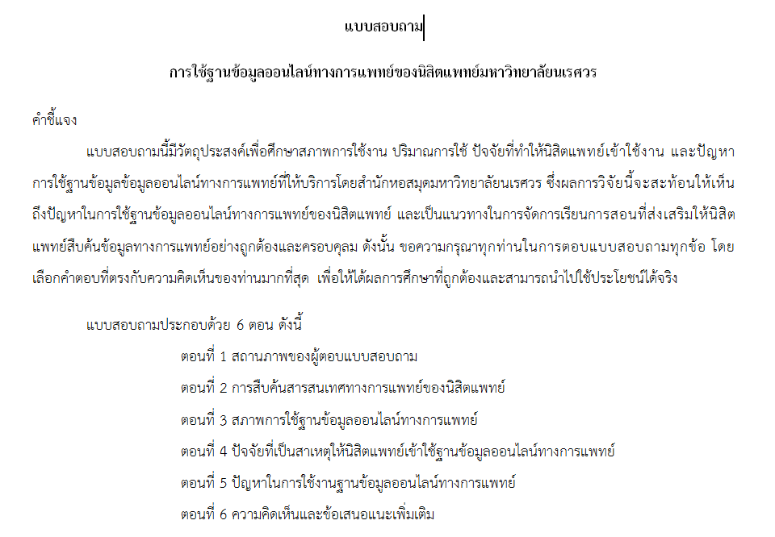
Design: The Questionaires
Paper
Google Doc (Online form)
Notes:
This are the example questionnaire that was distributed to medical student which composed of online questionnaire form and the paper form.

Slide 14
Ethical considerations
The questionnaire was accompanied with an ….
Introductory letter regarding confidentiality
The purpose of this study
Notes:
The medical ethic that was considered in this research was : the purpose of this study was clearly explained and an introductory letter regarding confidentiality was also being considered.

Slide 15
Results
Notes:
Ok now Let’s see the result!

Slide 16
Demographic data of respondents
Notes:
This compare response rate between clinical and preclinical students.
A total of two hundred and eighteen or seventy eight point four two percent (78.42%) of medical students completed the questionnaires,
fifty four point six 54.6 percent were pre-clinical students and the remaining were clinical students.

Slide 17
Using online medical databases
Have use
Notes:
This graph shows
The Majority of the clinical student (86.9%) have used the online medical database,
whereas,
the pre-clinical students have use in lesser extent about fourty one point two (41.2%) compared to clinical students.

Slide 18
Using online medical databases
Notes:
The clinical student tend to use the database more than the pre-clinical students significantly. At p value . O five (OR=9, 95%CI 4.7-18.8).
There are many online databases like uptodate,
pubmed,
OVID,
science direct
,md consult
Or etc
and
from all the available online databases it clear that
The AccessMedicine is the most popular database in both group
(there is sixty seven point three 67.3% in pre-clinical students
and seventy seven point nine percent 77.9% in clinical students)
followed by pubmed database 71.1%.

Slide 19
Frequency of using of online medical databases
Notes:
The frequency of using online medical databases shows
The Most of the clinical students access the online databases less than once a week (32.1%).
These are reflex that they use very limited.

Slide 20
Problem in using online medical data
No need to access the databnase
Information provided don’t fulfill the needs
No skill in searching information
Lack knowledge to join the database
Don’t know type of service that is being provided
Lack knowledge of availability of online service
Don’t know that we have an online database
Notes:
This study reveals the barrier of utilization of online medical databases and it shows that most of the medical students are not aware of online database services that are available in the Naresuan University Librar

Slide 21
Conclusion

Slide 22
Conclusion
Both pre-clinical and clinical medical students have a limited use of online medical databases
The main obstacles that they face is they are not aware of online medical database
Notes:
So therefore, It can be concluded that both pre-clinical and clinical medical students have a limited use of online medical databases.
The main obstacle to overcome is to promote the awareness of online databases that is available in the library.

Slide 23
Thank You

